Slide 1
Calibration Plots
2022-07-28

Slide 2
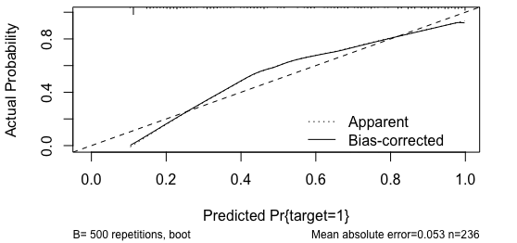
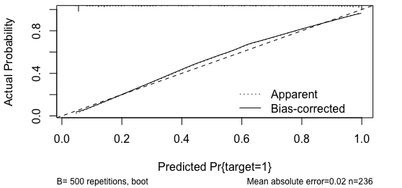
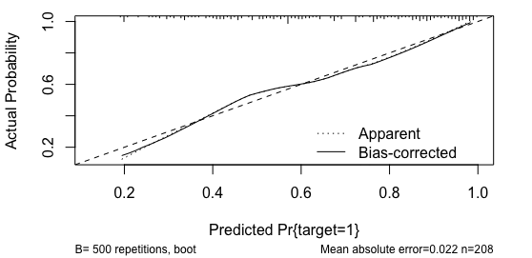
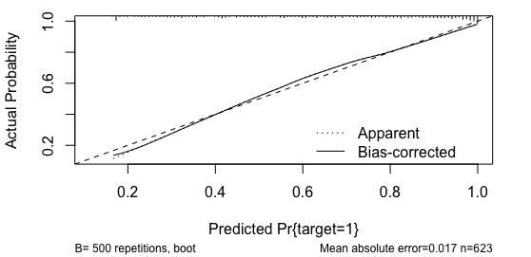
Model 1
Model 1’
DeNoPa
PPMI

Slide 3
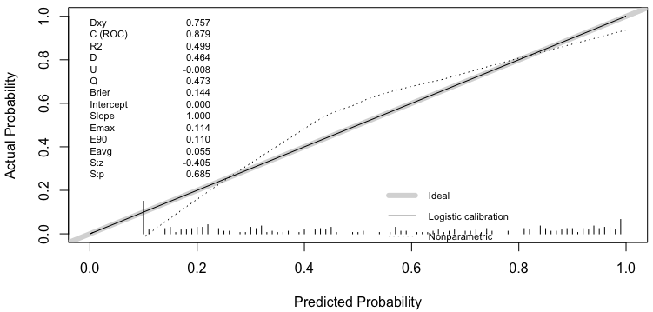
Statistics of the logistic regression model:
`fit <- lrm(target ~ score, df)`
Summary statistics for
calibration.
i.e., ICI
the Spiegelhalter Z-test for calibration accuracy, and its two-tailed P-value

